Slide 1
Assignment #2: Log Analysis for Anomaly Detection
Qianyu Ouyang
Notes:
I will introduce this assignment，log analysis for anomaly detection.

Slide 2
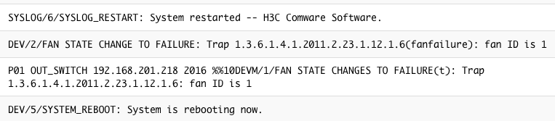

Background
traffic flow
Anomaly detection is important.
Besides KPI curves，logs are also widely used for anomaly detection.
Logs record detailed runtime information.
Notes:
As we all know, Anomaly detection plays an important role in management of large distributed system.
In addition to KPI，Logs are also widely used for anomaly detection
For example, in this case, a switch occurs an anomaly and we can find anomaly from log messages.
because logs record detailed runtime information .

Slide 3

Challenges
But checking logs manually is impossible!
Unstructured texts.
Huge amount of logs.
Diverse types of logs.
We need automated log-based anomaly detection methods!
I can not check logs manually!
Notes:
But checking logs manually is impossible! There are many challenges.
Most log messages are unstructured texts.
In addition, there are huge amount of logs.
Tens of millions of log messages are generated everyday.
The third challenge is the diverse types of log messages.
So, we need automated log-based anomaly detection methods!

Slide 4
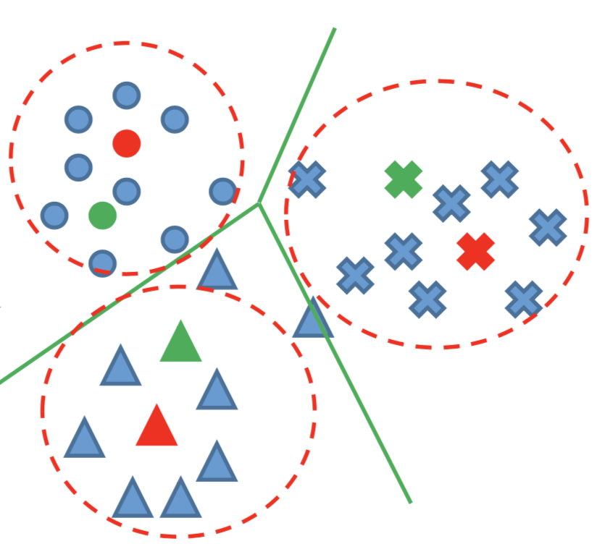
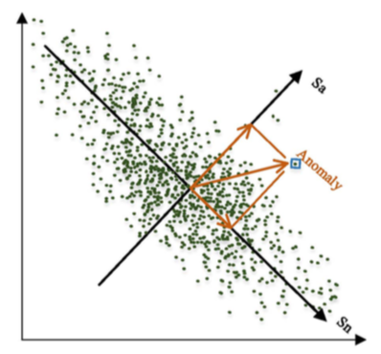
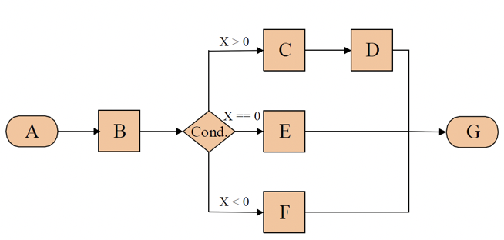






Popular Framework of log anomaly detection
Logs:
1.Interface ae3, changed state to down
2.Vlan-interface vlan22, changed state to down
3.Interface ae3, changed state to up
4.Vlan-interface vlan22, changed state to up
5.Interface ae1, changed state to down
6.Vlan-interface vlan20, changed state to down
7.Interface ae1, changed state to up
8.Vlan-interface vlan20, changed state to up
Templates：
1.Interface *, changed state to down
2.Vlan-interface *, changed state to down
3.Interface *, changed state to up
4.Vlan-interface *, changed state to up
Log.->Templates:
L1->T1 L2->T2 L3->T3 L4->T4
L5->T1 L6->T2 L7->T3 L8->T4
Template sequence:
T1, T2, T3, T4, T1, T2, T3, T4
Sliding/ session windows
$$∆t$$
$$∆t$$
$$∆t$$
$$∆t$$
$$∆t$$
Count Matrix
Sliding/ session windows
$$\left[\begin{matrix}\begin{matrix}1 \\ 0 \\ 1\end{matrix} & \begin{matrix}\begin{matrix}1 \\ 1 \\ 0\end{matrix} & \begin{matrix}\begin{matrix}1 \\ 1 \\ 1\end{matrix} & \begin{matrix}0 \\ 1 \\ 1\end{matrix}\end{matrix}\end{matrix}\end{matrix}\right]$$
$$∆t$$
$$∆t$$
$$∆t$$
$$∆t$$
$$∆t$$
Clustering
PCA
Sliding/ session windows
$$∆t$$
$$∆t$$
$$∆t$$
$$∆t$$
$$∆t$$
Invariants mining
Log Collection
Log Parsing
Feature Extraction
Anomaly Detection
Log parsing methods^{[1]}:
LogSig (CIKM’11)
LKE (ICDM’09)
IPLoM (KDD’09)
SLCT (IPOM’03)
Anomaly detection mathods^{[2]}:
PCA (SOSP’09)
Invariants Mining (ATC’10)
Part#1 of assignment
Part#2 of assignment
[1]He P, Zhu J, He S, et al. An Evaluation Study on Log Parsing and Its Use in Log Mining[C]// IEEE DSN 2016
[2] He S, Zhu J, He P, et al. Experience Report: System Log Analysis for Anomaly Detection[C]// IEEE, ISSRE 2016.
Notes:
This figure shows a popular framework of log anomaly detection. The first step is log collection.
Then, we need to parse logs by getting templates from logs, and map all logs into templates.
Many log parsing methods are presented, such as LogSig. Log parsing is the part#1 of our assignment.
After log parsing， we usually do feature extraction from template sequence.
Finally, we use feature matrix to do anomaly detection. There are many effective anomaly detection methods. These two steps are the part 2 of our assignment.

Slide 5
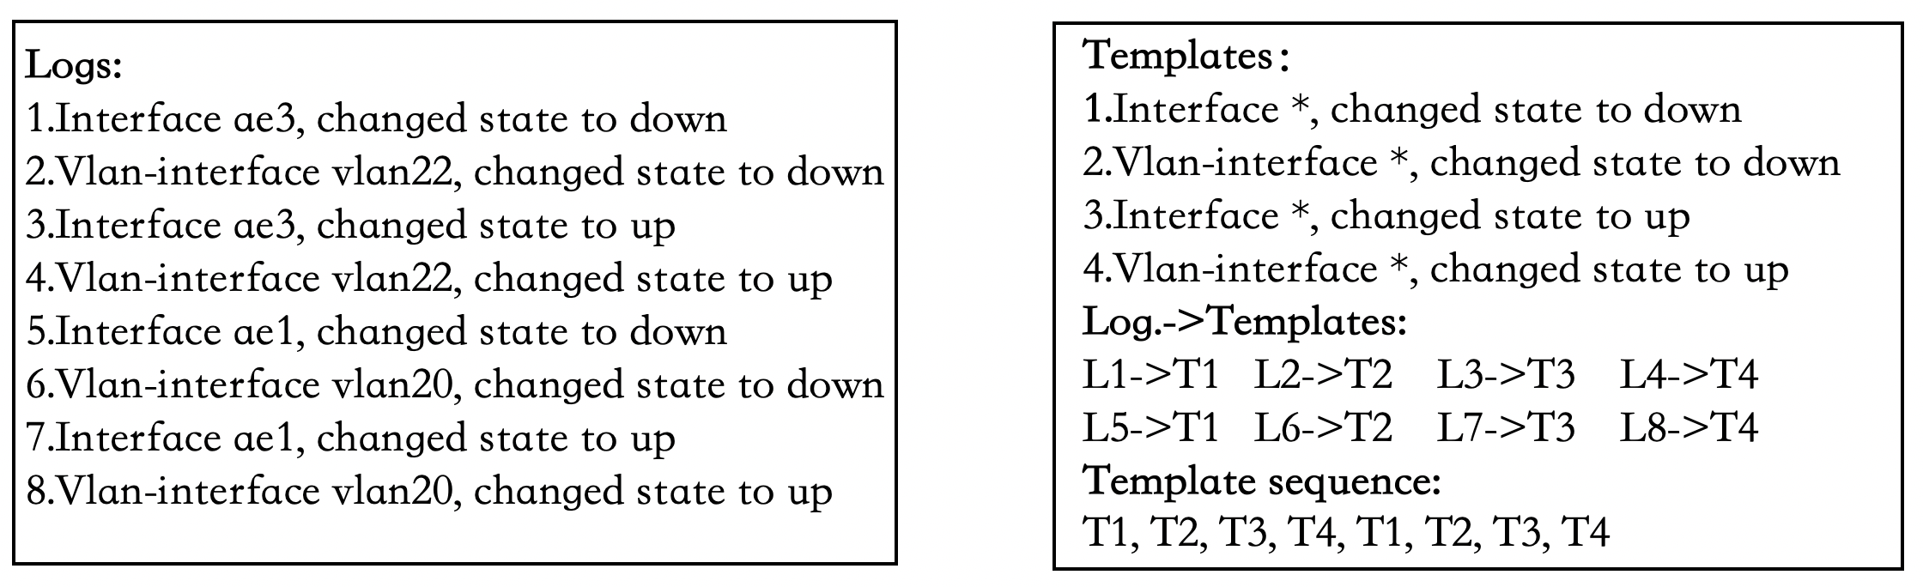
Part#1: comparing current log parsing methods
The purpose of log parsing is to extract a group of event templates.
DSN paper^{[1]} introduces many methods for automated log parsing.
Toolkit:
https://github.com/logpai/logparser/tree/dev
Algorithms: LogSig, IPLoM, SLCT, LKE
[1]He P, Zhu J, He S, et al. An Evaluation Study on Log Parsing and Its Use in Log Mining[C]// IEEE DSN 2016
Notes:
Now， I will introduce this assignment in detail.
The first part is comparing current log parsing methods.
The purpose of log parsing is to extract a group of event templates.
For example, the first and fifth logs can map to the first template， They all denote “interface down” event.
The DSN paper introduces a number of methods for log parsing.
There is a toolkit for log parsing on github, this toolkit include various log parsing algorithms, LogSig， IPLoM， SLCT and LKE.

Slide 6
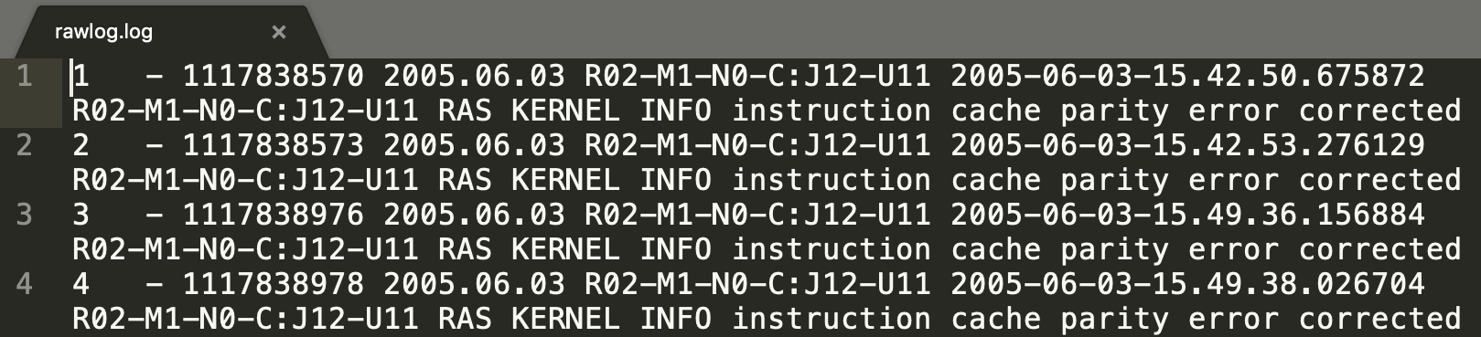
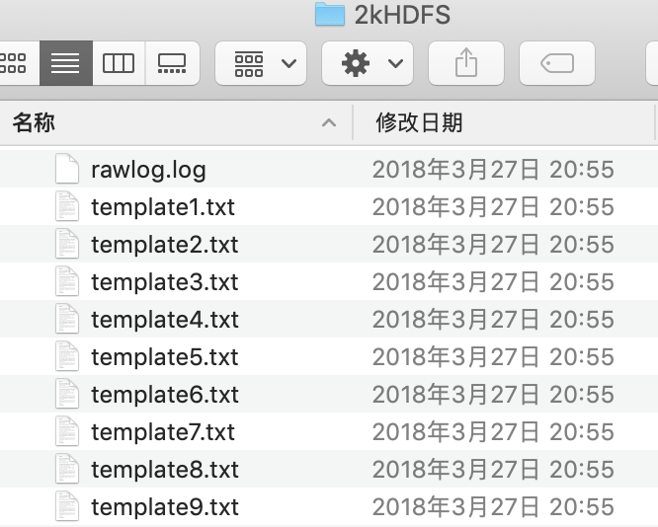
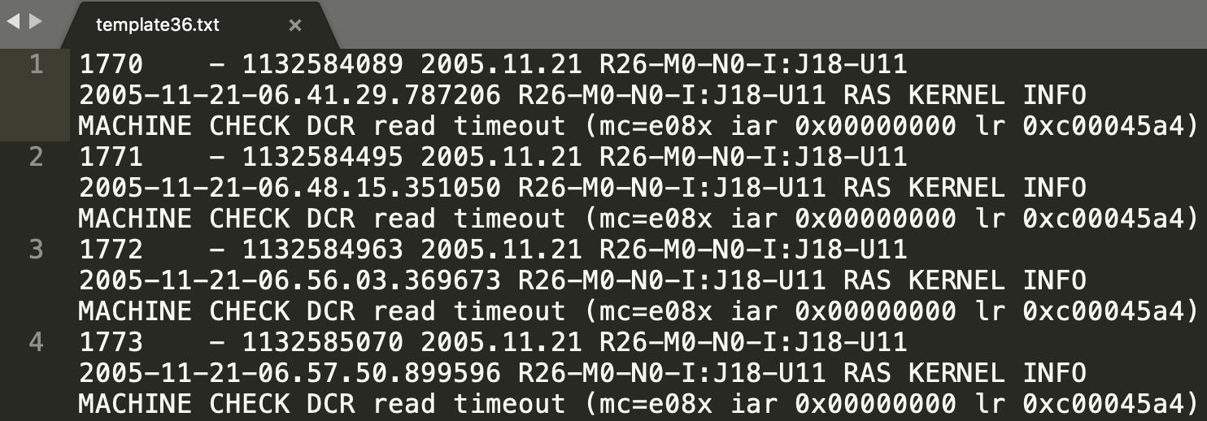
Part#1: comparing current log parsing methods
Dataset:
https://github.com/logpai/logparser/tree/dev/data
Five types of logs (BGL, HDFS, HPC, Proxifier, Zookeeper), each type has 2000 logs.
In each type:
“rawlog.log” is the logs that you need to process.
Logs in “template**.txt”belong to the same template (groundtruth for classification)
rawlog.log
template36.log （groundtruth）
Notes:
We use open-source log dataset of part1. There are five types of logs and Each type has 2000 logs.
In each type, there are two kinds of files.
Logs in the same template file belong to the same template,
you can regard these files as ground truth to verify and evaluate your log parsing results.

Slide 7
Part#1: comparing current log parsing methods
Learn the DSN 16 paper (or original paper for these log parsing methods) and do the following jobs using the given datasets:
Learn four log parsing algorithms: LogSig, IPLom, SLCT and LKE
Use toolkit to run the four log parsing algorithms on five datasets (BGL, HDFS, HPC, Proxifier, Zookeeper).
Plot runtime, F-score, RandIndex^{[3]} (a metrics for evaluation clustering) with bar charts when four algorithms are parsing logs.
Display your template files.
Describe your own experience or findings in doing log pasrsing. For example, advantages and disadvantages of these algorithms.
[3] https://nlp.stanford.edu/IR-book/html/htmledition/evaluation-of-clustering-1.html
Notes:
These are the detailed requirements for part1.

Slide 8
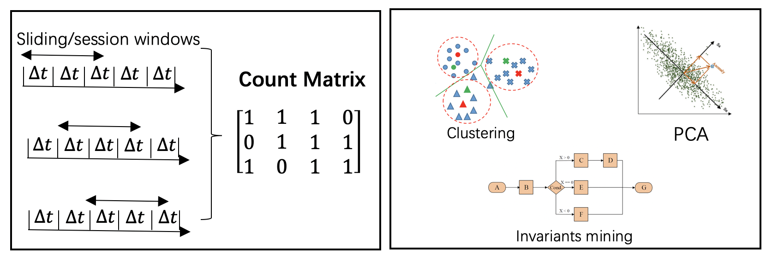
Part#2: comparing anomaly detection methods
ISSRE paper^{[2]} introduces many approaches for anomaly detection based on log sequence.
Toolkit：
https://github.com/logpai/loglizer
[2] He S, Zhu J, He P, et al. Experience Report: System Log Analysis for Anomaly Detection[C]// IEEE, ISSRE 2016
Notes:
The second part of assignment2 is comparing anomaly detection methods.
In this part, you will implement the log detection to find out anomalous file blocks in HDFS.
The paper^{[2]} introduces many approaches for anomaly detection based on log sequence.
Here, we also have a toolkit for log anomaly detection.

Slide 9
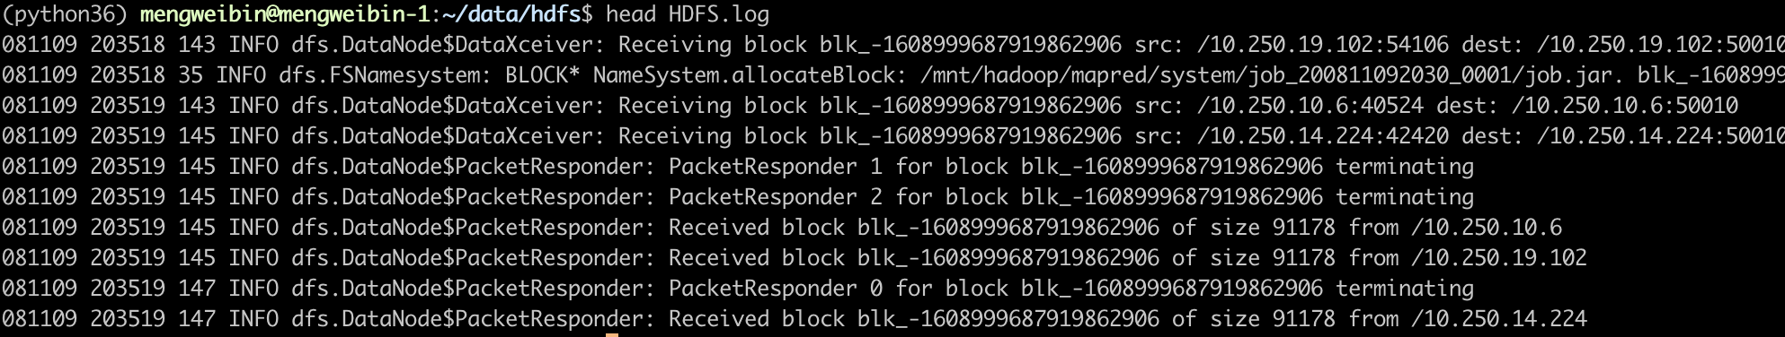
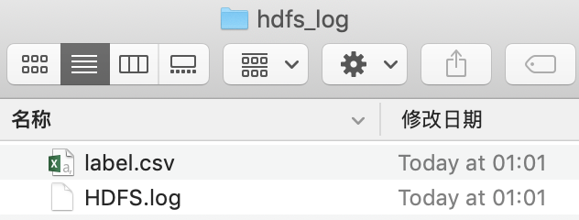
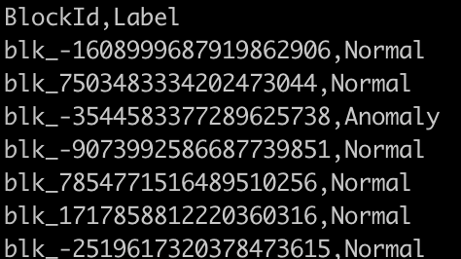
Part#2: comparing anomaly detection methods
Dataset (HDFS logs)：
https://www.dropbox.com/s/akef557hnla0h9v/ANM-data.zip?dl=0
HDFS.log
label.csv
Notes:
The dataset include two files.
HDFS.log records raw logs. In this file, some logs are belong to a same block.
Label.csv is the groundtruth for each block. The first columnis blockid, the second column is label.

Slide 10
Part#2: comparing anomaly detection methods
Learn the ISSRE paper (or original paper for these anomaly detection methods) and do the following jobs using the HDFS logs.
Learn three unsupervised anomaly detection models: Invariants Mining, PCA and Log Clustering.
Choose a log parsing method (mentioned in part1) to parse HDFS logs, and use this toolkit to run two of three anomaly detection models (Considering Log Clustering suffers from high computational complexity, you needn’t run Log Clustering).
Plot precision, recall, F-score ,runtime with bar charts when these models detecting anomaly.
When running Invariants Mining, add some codes and display three relationships (please check the paper for more information), e.g., n(A) = n(B), where n(∗) represents the number of logs which belong to corresponding template ∗. And explain why, e.g., template A is “Interface *, changed state to down”, while template B is “Interface *, changed state to up”.
Describe your own experience or findings in doing those jobs.
Notes:
These are our requirments.
You need to learn the ISSRE paper and do the following jobs using the HDFS logs.

Slide 11
When you finish this assignment, you only need to submit a zip file , which includes template files in part#1 and an assignment report.
Notes:
Finally, when you finish this assignment, You only need to submit a report without submitting the code.

Slide 12
Q&A

